Slide 1

18CSC202J - OBJECT ORIENTED DESIGN AND PROGRAMMING
Session 13
Topic : UML Deployment Diagram, Examples

Slide 2
Guidelines to Draw: Deployment Diagram
Identify the hardware components and processing units in the target system.
Analyze the software and find out the subsystem, parallel execution of modules, server side components, client side components, business logic components, backend database servers and software and hardware mapping mechanism to map the software components to be mapped with appropriate hardware devices.
Draw the hardware components and show the software components inside them and also show the connectivity between them.

Slide 3


Notations
S.NO | NAME | SYMBOL | DESCRIPTION
1 | Node |  | A node represents a physical component of the system. Node is used to represent physical part of a system like server, network etc.
2 | Association |  | A structural relationship describing a set of links connected between objects.

Slide 4
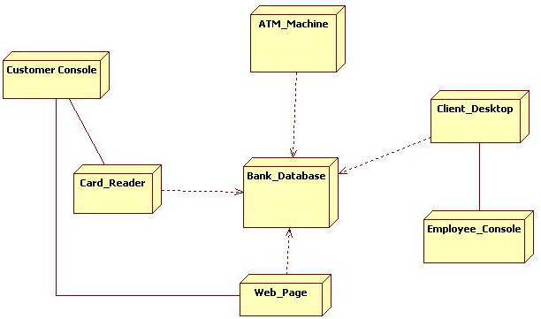
Example

Slide 5
Example
online shopping UML diagrams
Ticket vending machine UML diagrams
Bank ATM UML diagrams
Hospital management UML diagrams
Digital imaging and communications in medicine (DICOM) UML diagrams
Java technology UML diagrams
Application development for Android UML diagrams

